Slide 1


Where finding the perfect Talent
is made easy & fun!

Slide 2


What do we solve?
Finding the right talent can be a challenging task in the hiring process.
Creating a standout and polished resume poses a significant challenge for candidates in the professional sphere

Slide 3


Solution
Resume generator
Hiring solution
Enhanced candidate experience: Create cv using Voice record
Data-driven decision-making matching system
Our resume generator and matching system are powered by the OpenAI solution.

Slide 4








Overview
A Massive Updated CV-tech
A User centred design
Enhanced candidate experience : Create cv using Voice record
Affordable
Easy apply to jobs
Data-driven decision-making matching system

Slide 5
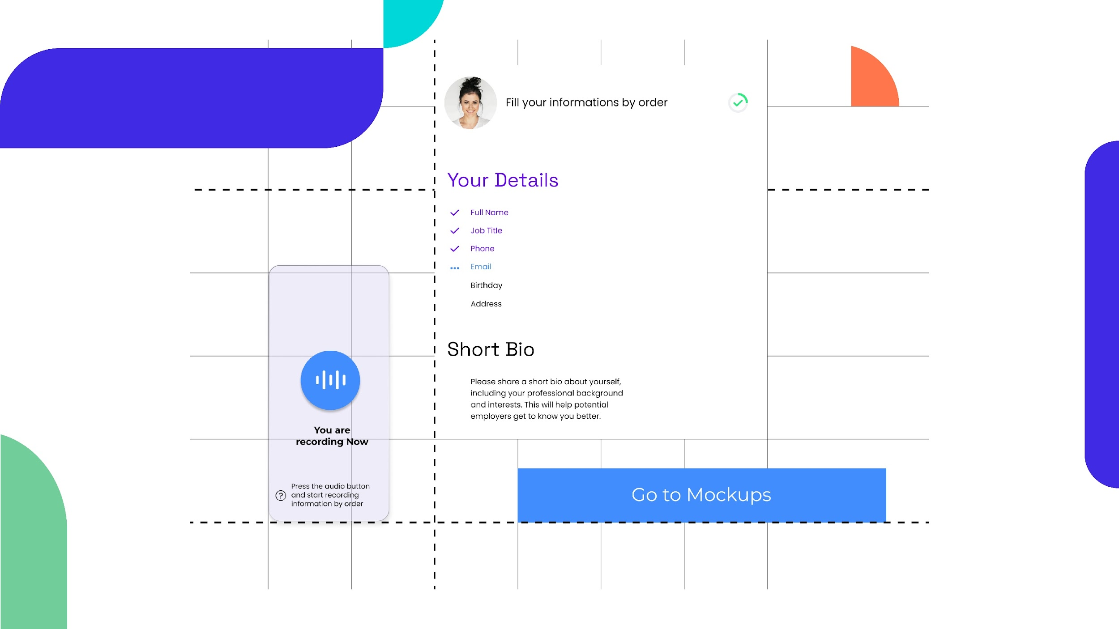
Resume creation with voice
Convert Voice record to Resume
Resume Mockups
Guided steps
Upload Photo

Slide 6
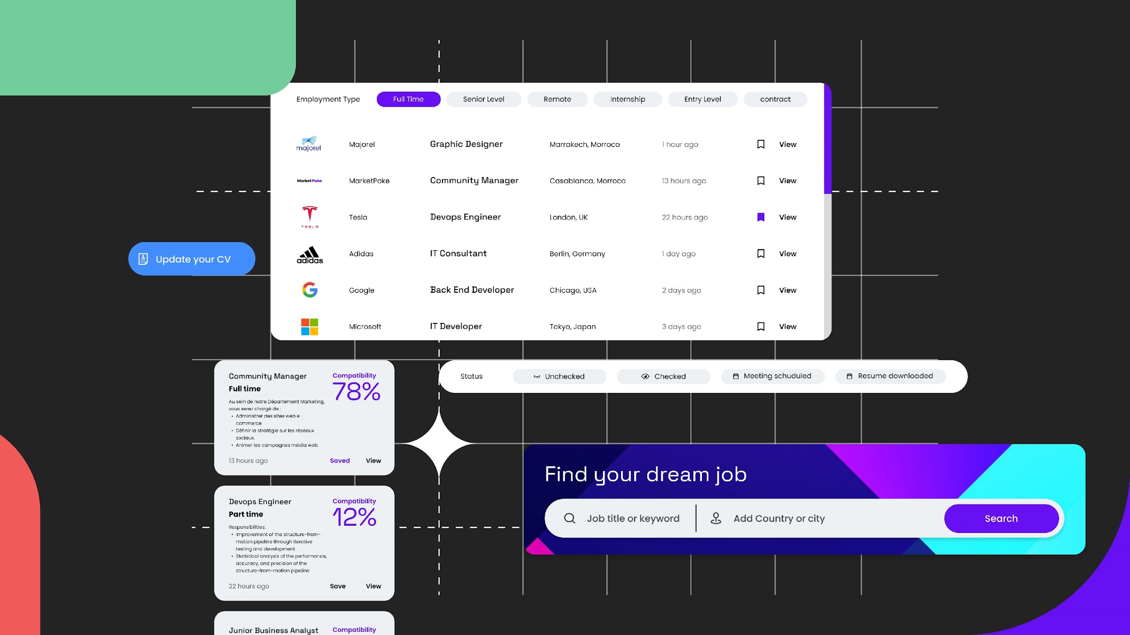
Candidates features
Stastics of every
Offer created
A note space
In the dashboard
Managable offer
Messaging tool
Managable offer
Messaging tool

Slide 7
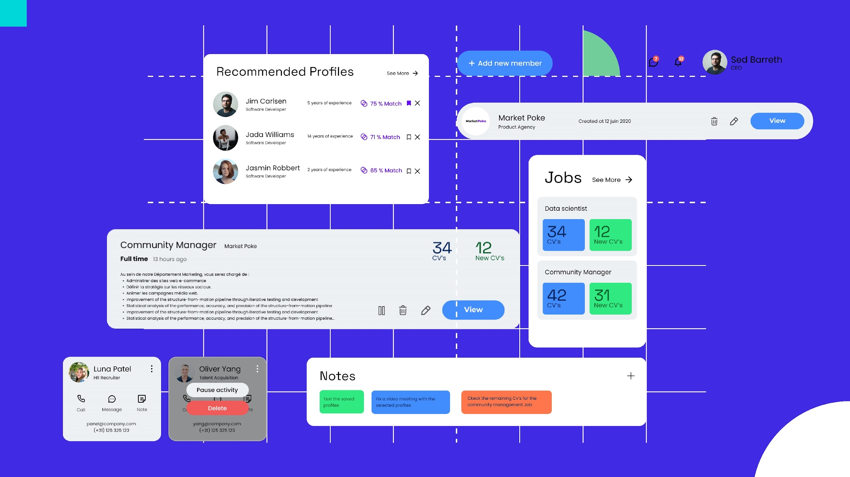
Recruiters features
Matching rate for
Every candidate
RH team space
Stastics of every
Offer created
A note space
In the dashboard
Managable offer
Messaging tool

Slide 8


What sets us apart
from competitors?
1
We offer a fair and transparent evaluation of candidates.
2
Candidates can easily get recommended and apply
3
A business account can have many business in one
4
Sorting through a large pool of unqualified resumes
5
Sorting through a large pool of unqualified resumes

Slide 9





Business Model
Revenue Abonnements
Des frais d'abonnement en fonction du nombre d'offres d'emploi et de la taille de l'entreprise et les fonctionnalités
Revenue Marque employeur
Production des contenus et présence sur l’ensemble des supports de communication Jobold.
Revenue Publicité
Des espaces dédiés aux spots publicitaires au niveau de la plateforme

Slide 10

Financial projection
2026
400K MAD
2025
250K MAD
75K MAD
2024
Forecasted sales
Projected revenue

Slide 11
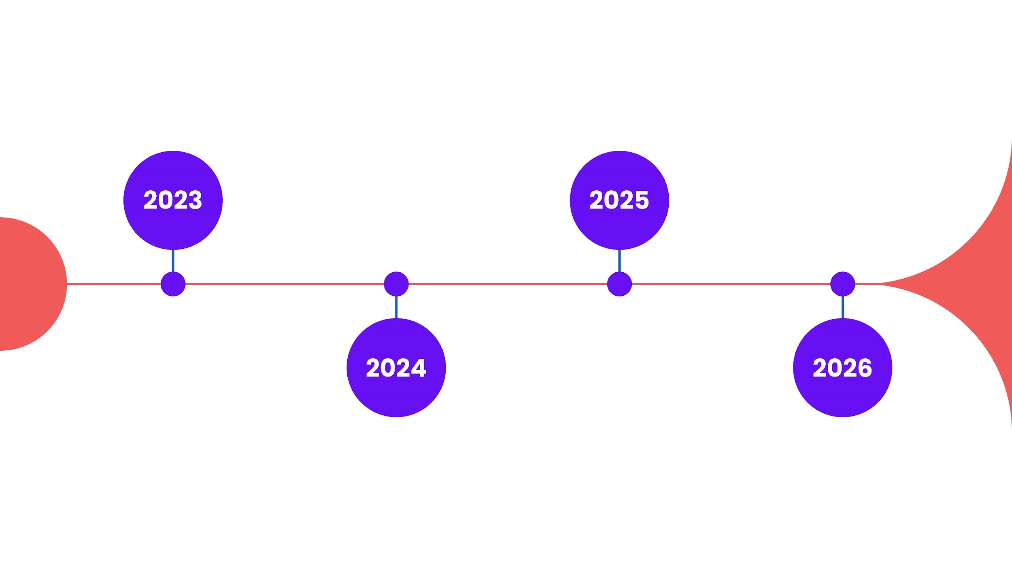

Acquisition plan
Scaling/VC
Product fit
Multichannel communication
MVP
Early adopters PR
Pre-incubation at Orange starton
Scaling
Market Fit
Client idéal
Companies with high employee turnover rate :
• Call centers
• Recruitment agencies
• Multinationals

Slide 12


Partnership
and Collaboration
Our startup aims to establish partnerships with schools to enrich our CV library. We seek to provide practical experience opportunities to students while identifying future talents for our partner companies
We will forge alliances with industry leaders, recruitment agencies, and HR platforms to expand our reach and maximize the value we deliver.

Slide 13


Slide 14


Thank you
Jobold.com
business@jobold.com

